Slide 1
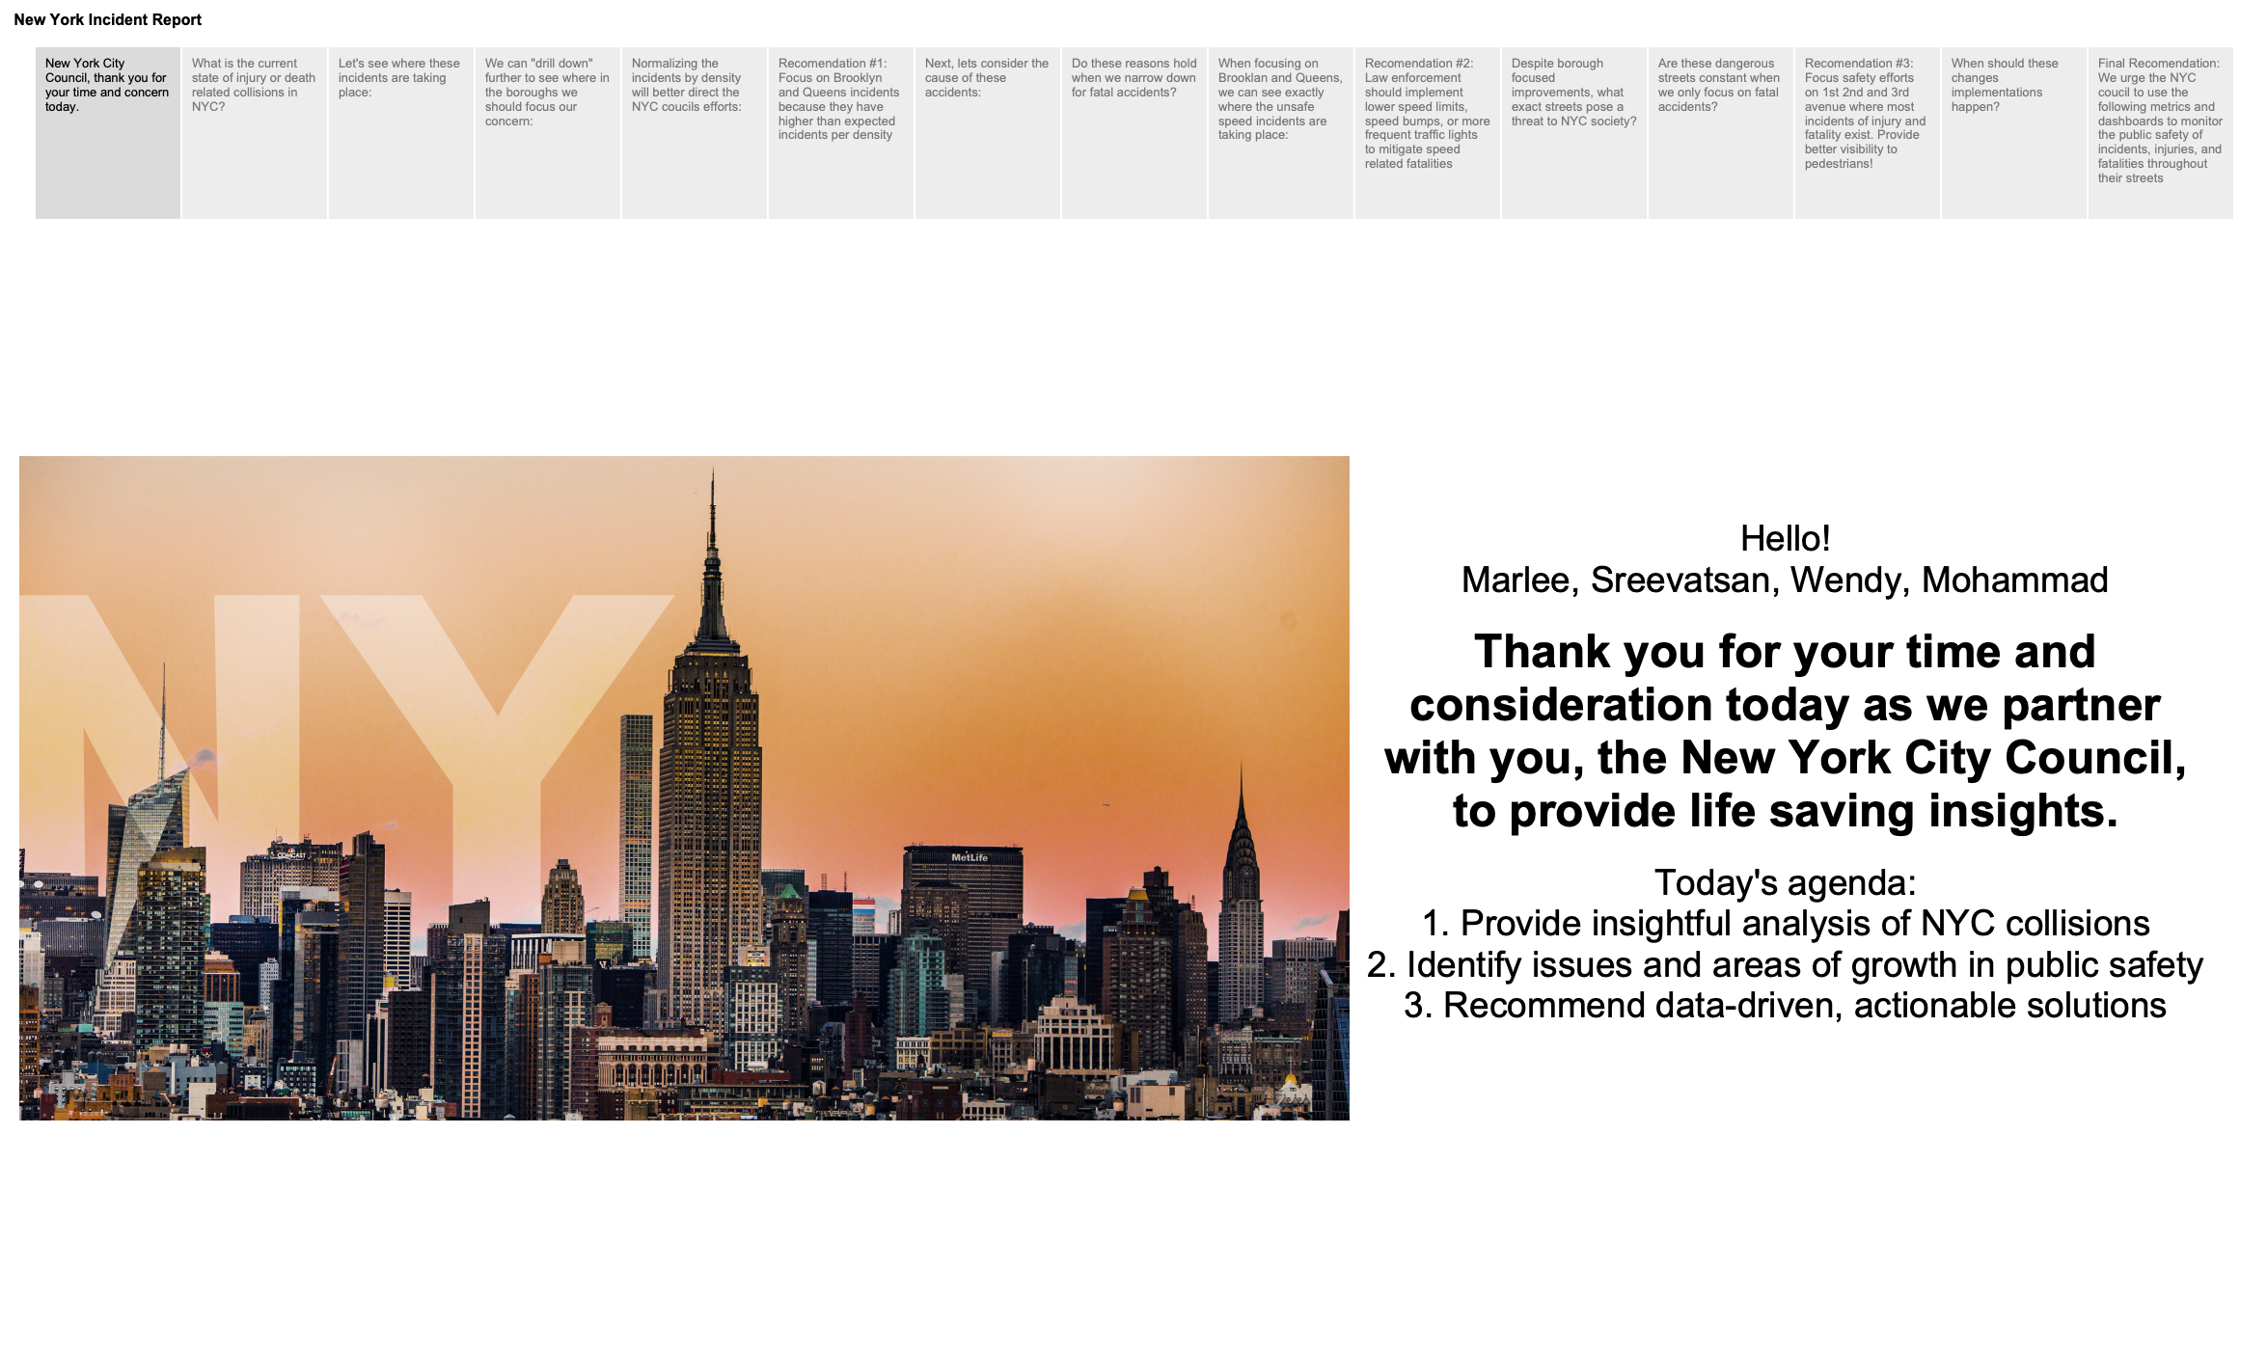

Slide 2
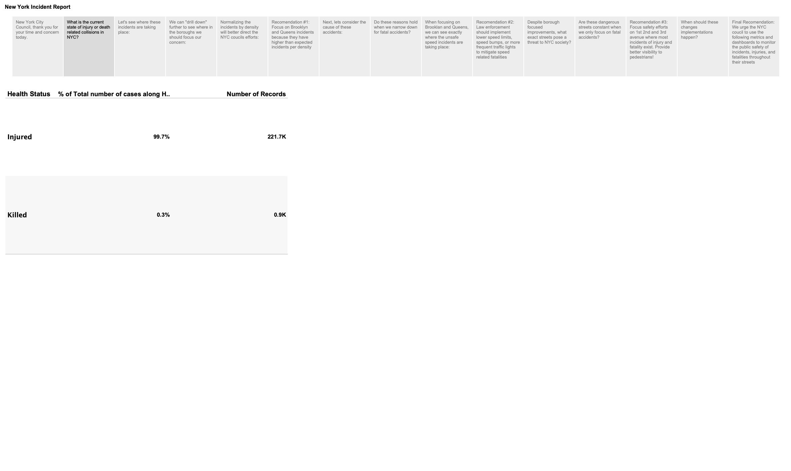
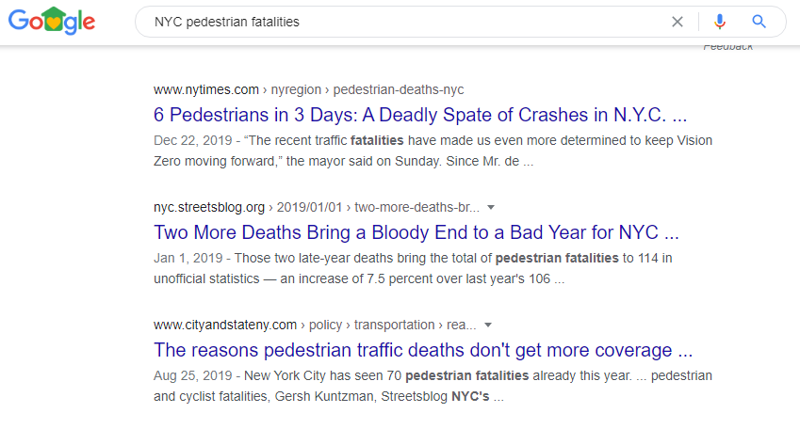
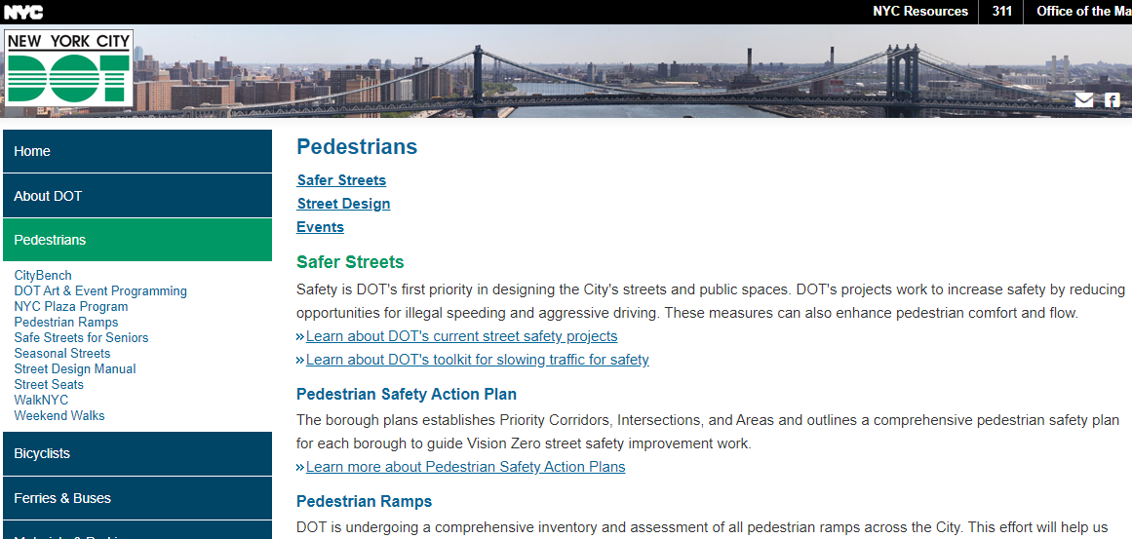

Slide 3
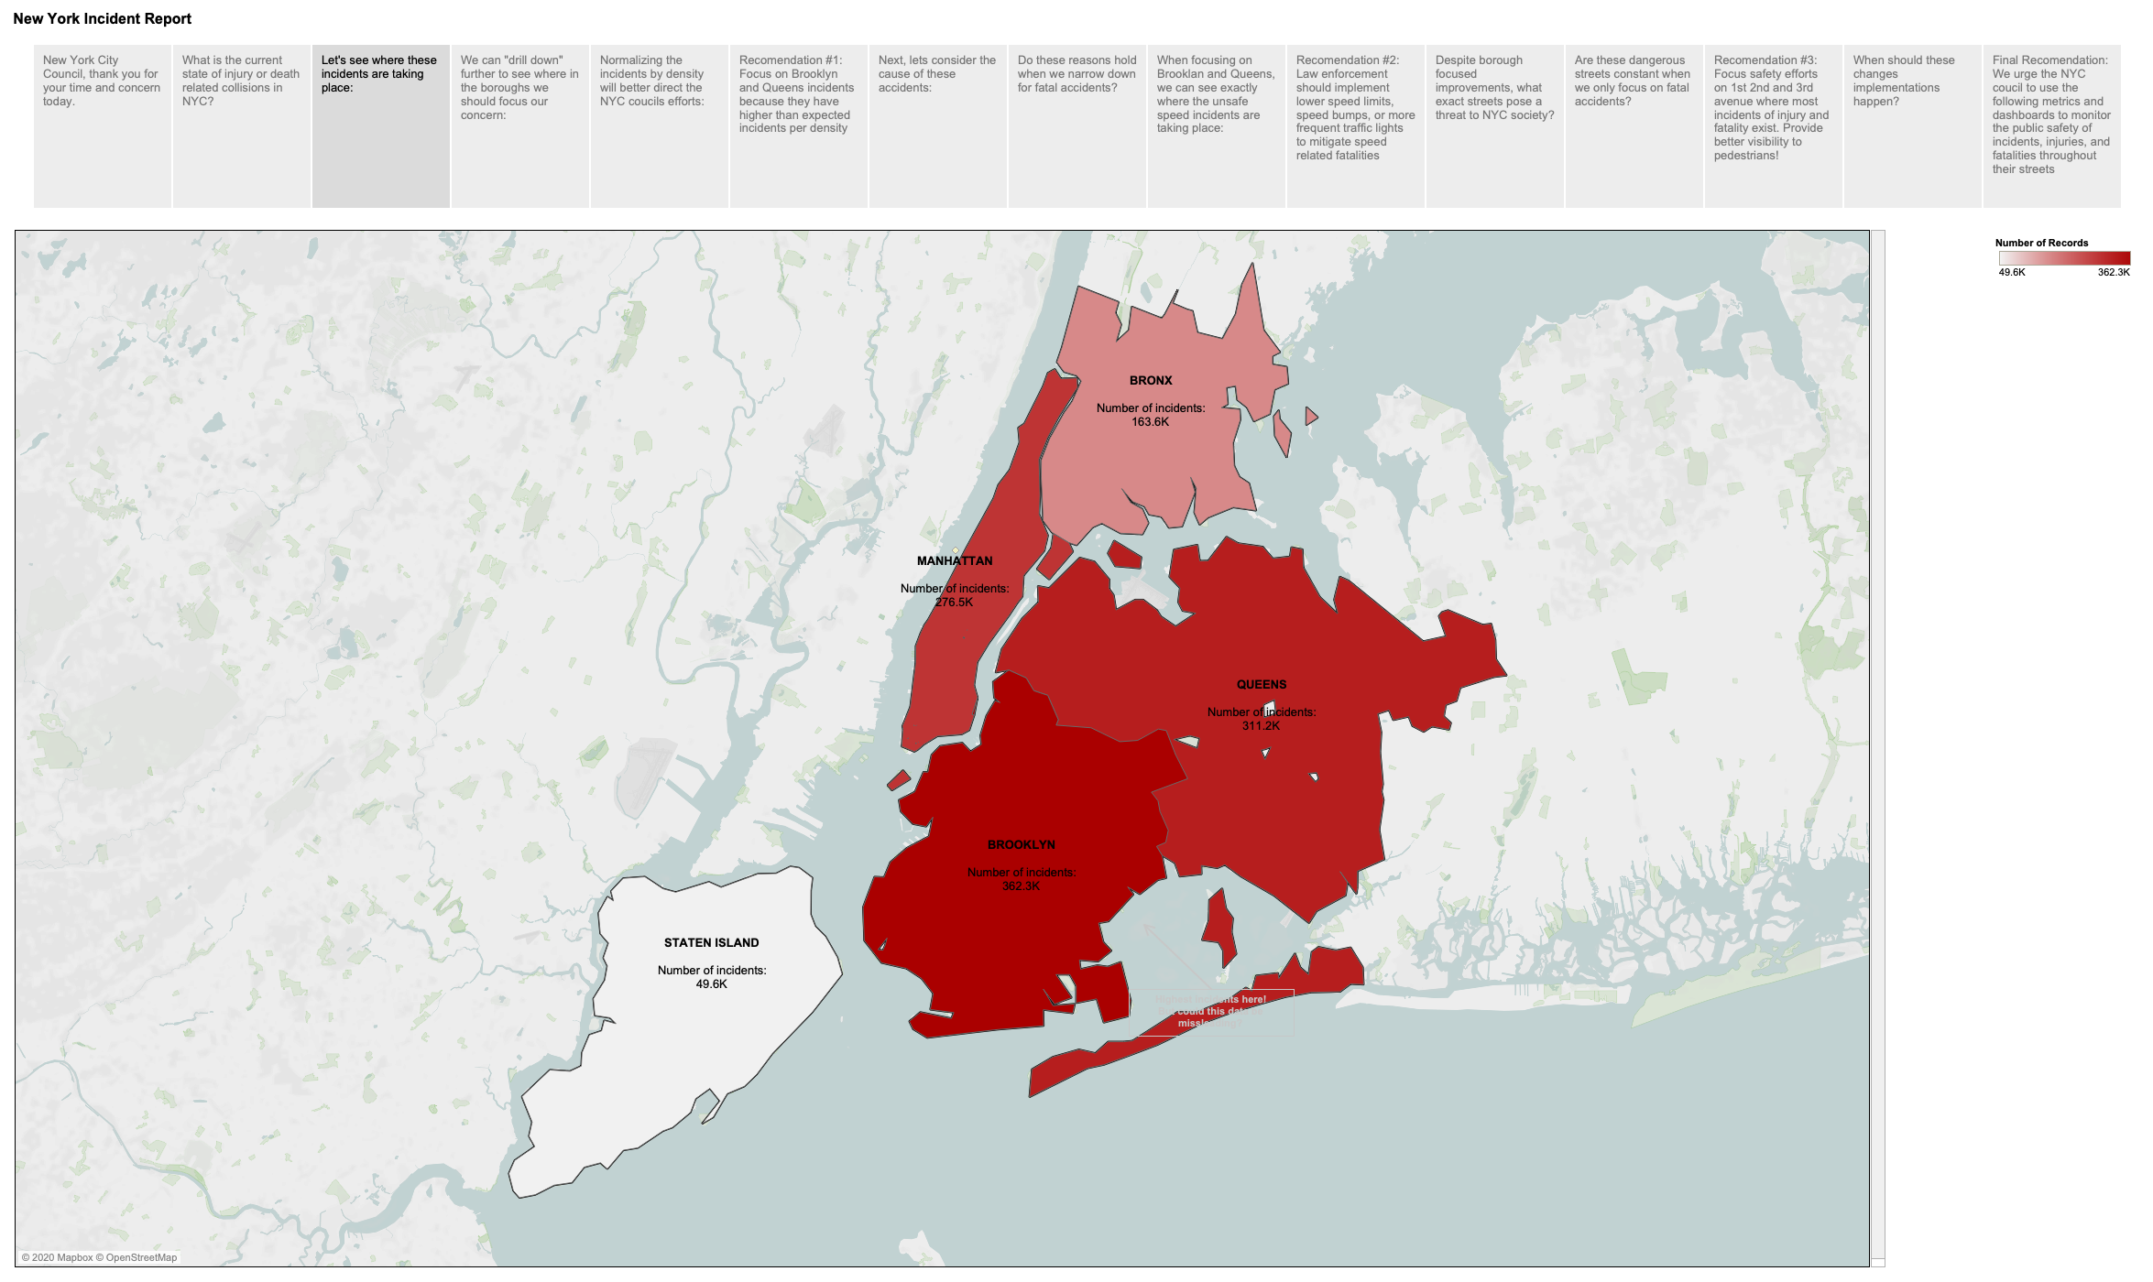

Slide 4
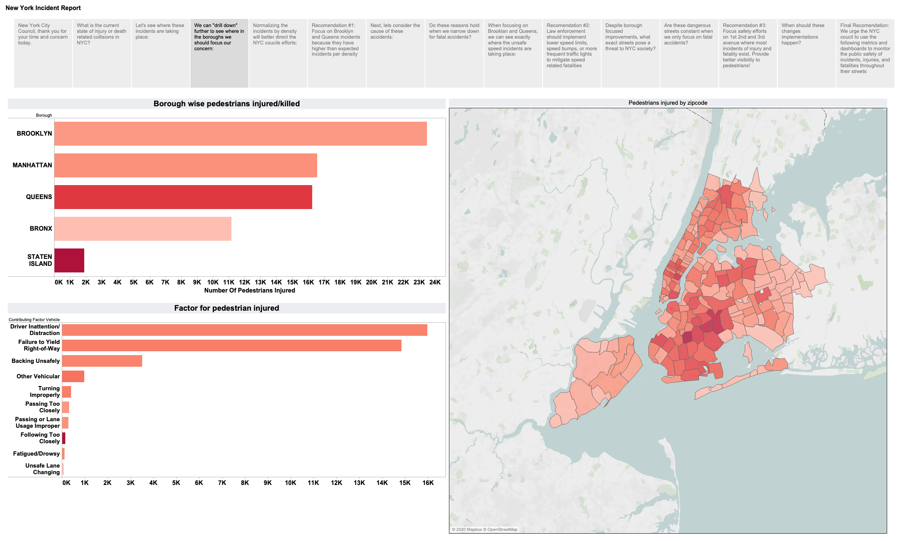

Slide 5
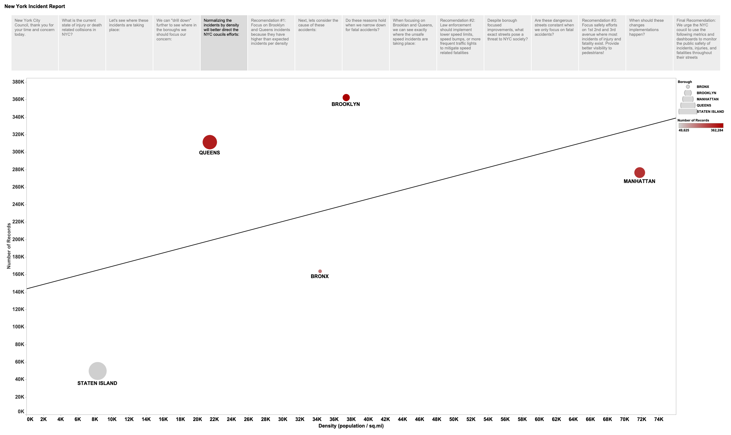


Slide 6
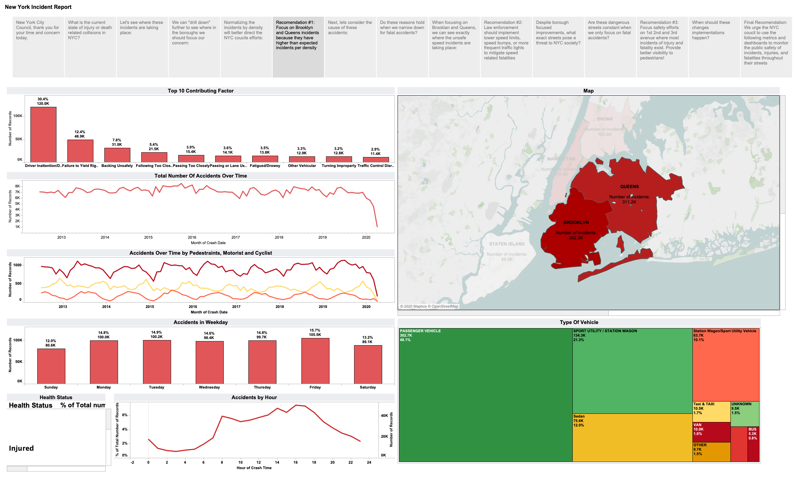

Slide 7
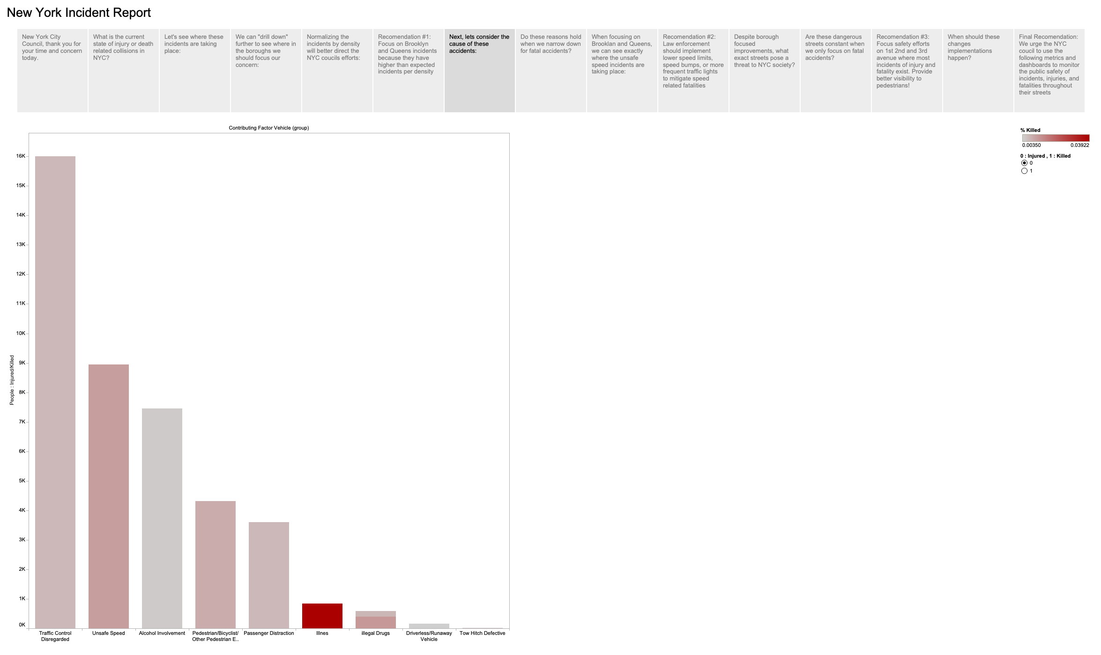
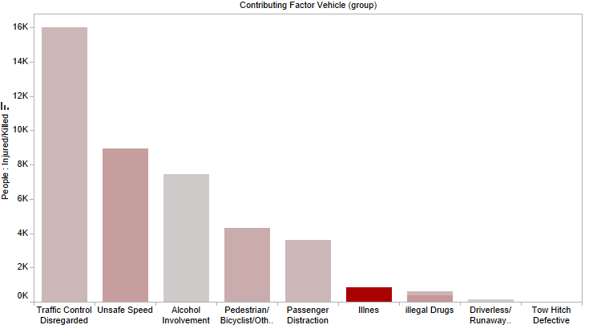
Top 10 causes of the accidents we are analyzing:
Traffic Control Disregard
Unsafe Speed
Alcohol Involvement
Top 3 causes are punishable by law, but what should our main concern be?

Slide 8
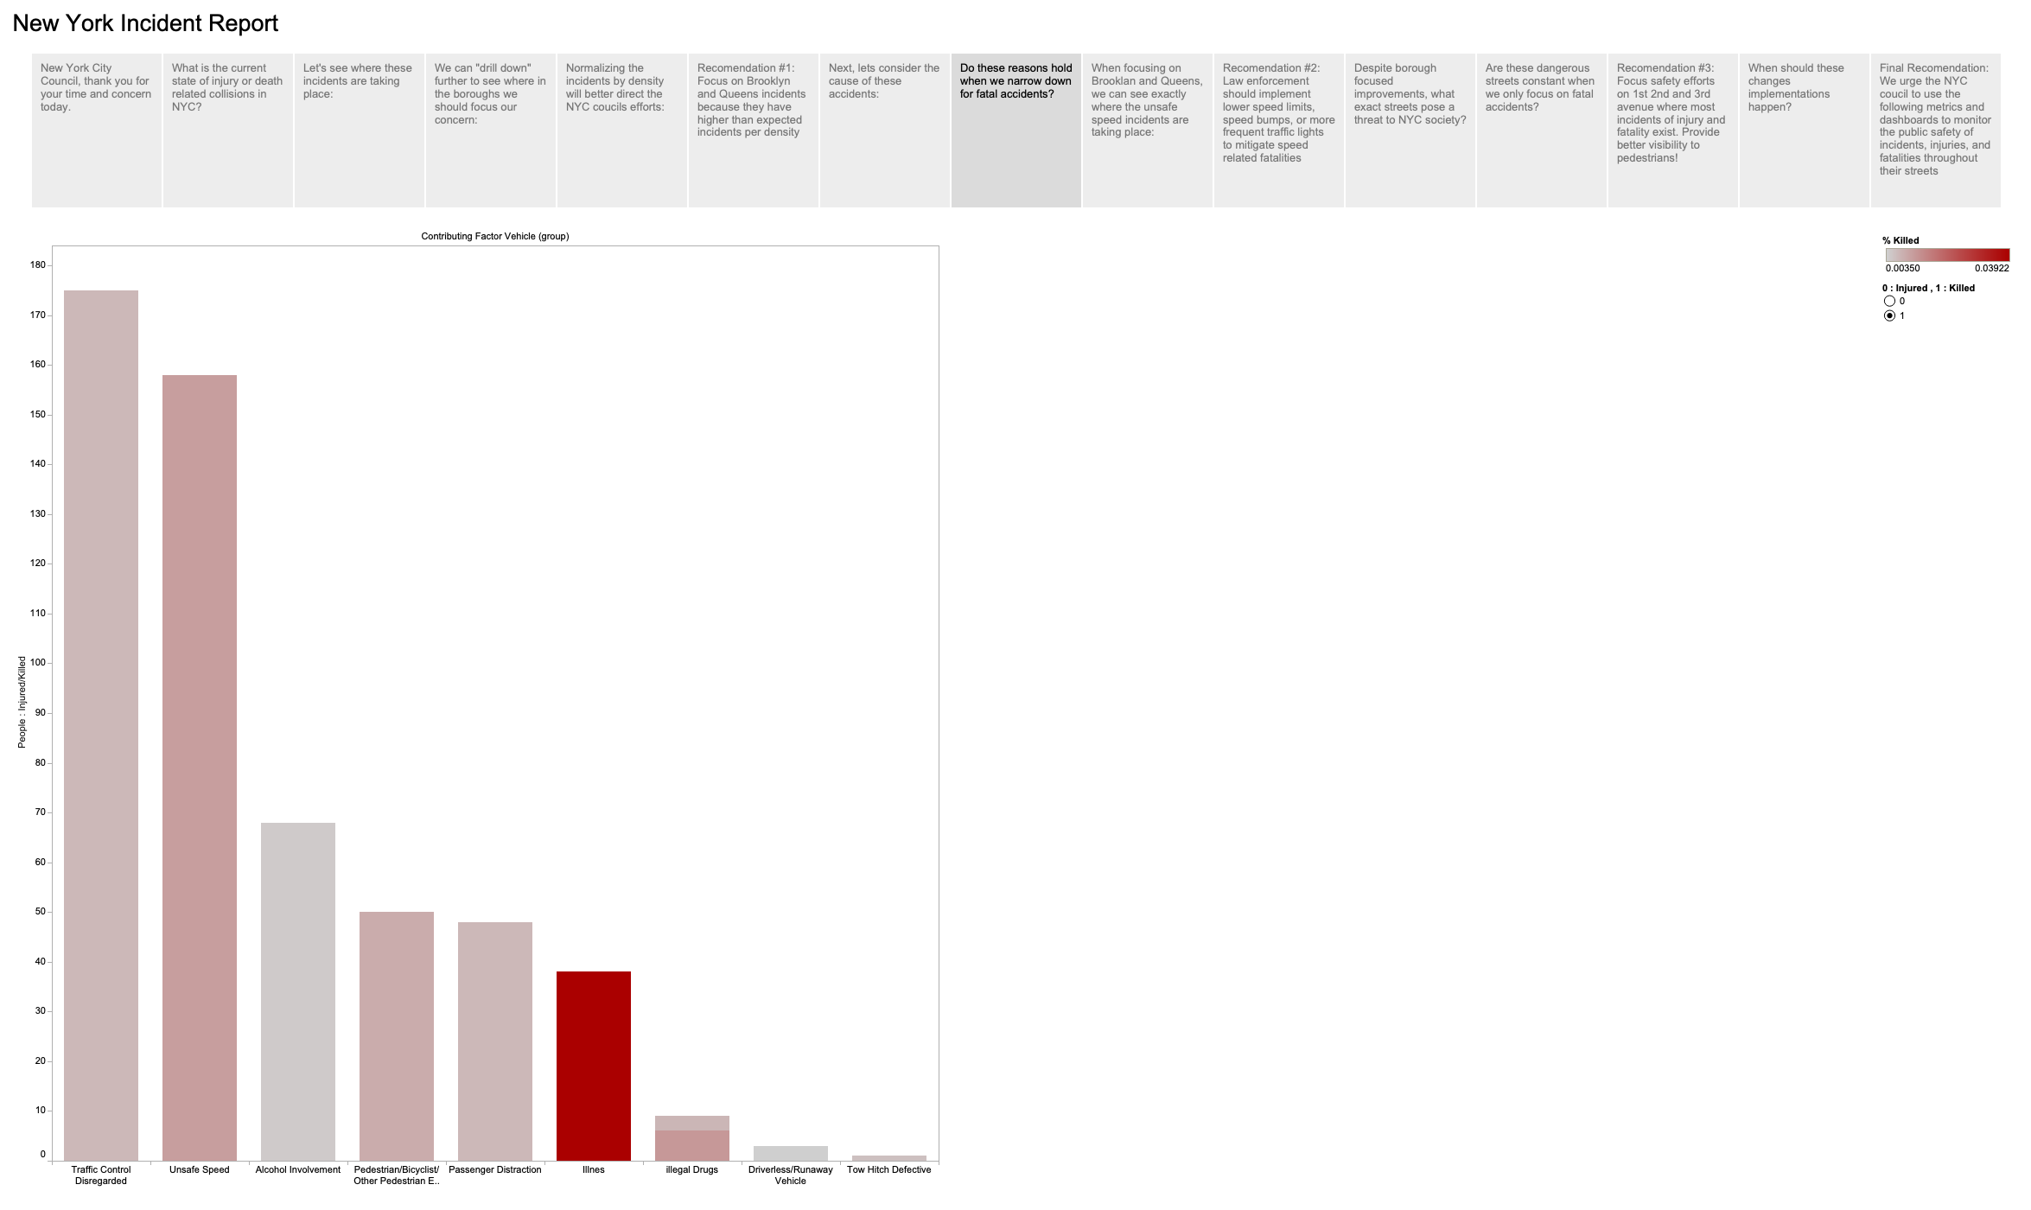
Top 10 causes of the accidents we are analyzing:
Traffic Control Disregard
Unsafe Speed
Alcohol Involvement
Speed violations are abnormally fatal to pedestrians

Slide 9
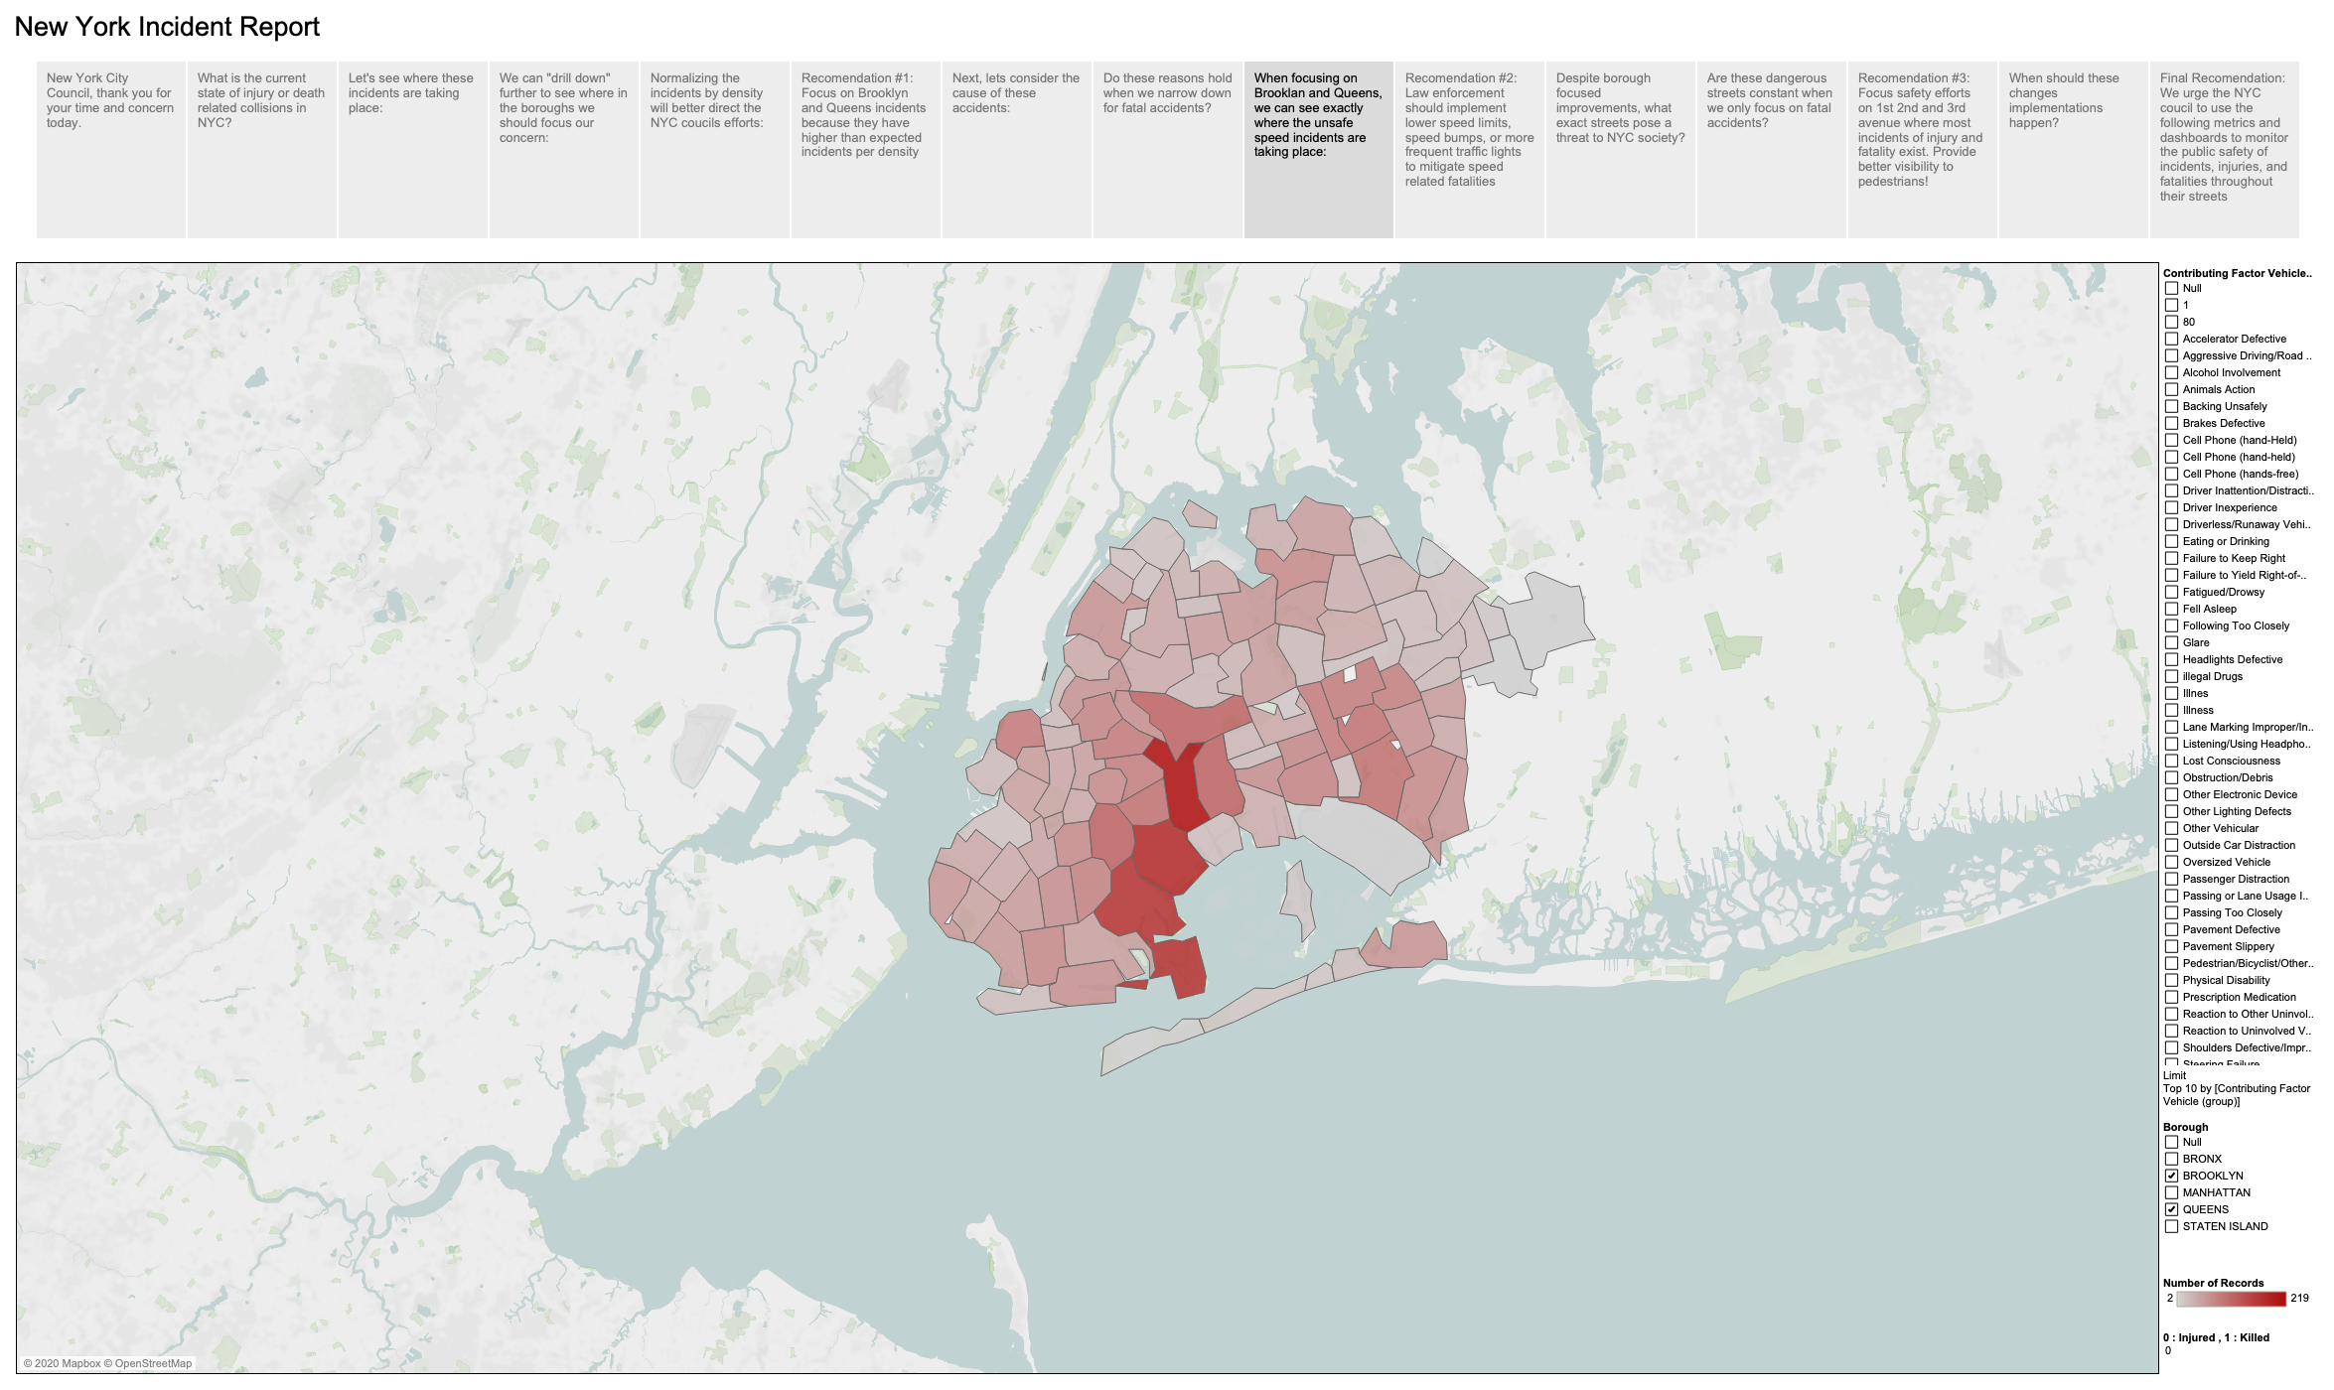
Where are these deathly violations happening within Brooklyn and Queens?
Zip Code 11207

Slide 10


The world bank blogs stated that
“At 30 km per hour, a pedestrian has a 90% chance to survive an impact. But if a vehicle hits you at 50 km/h while you’re walking down the street, that collision will have the same impact a falling from the fourth floor of a building.
Some solutions for improving pedestrian safety

Slide 11
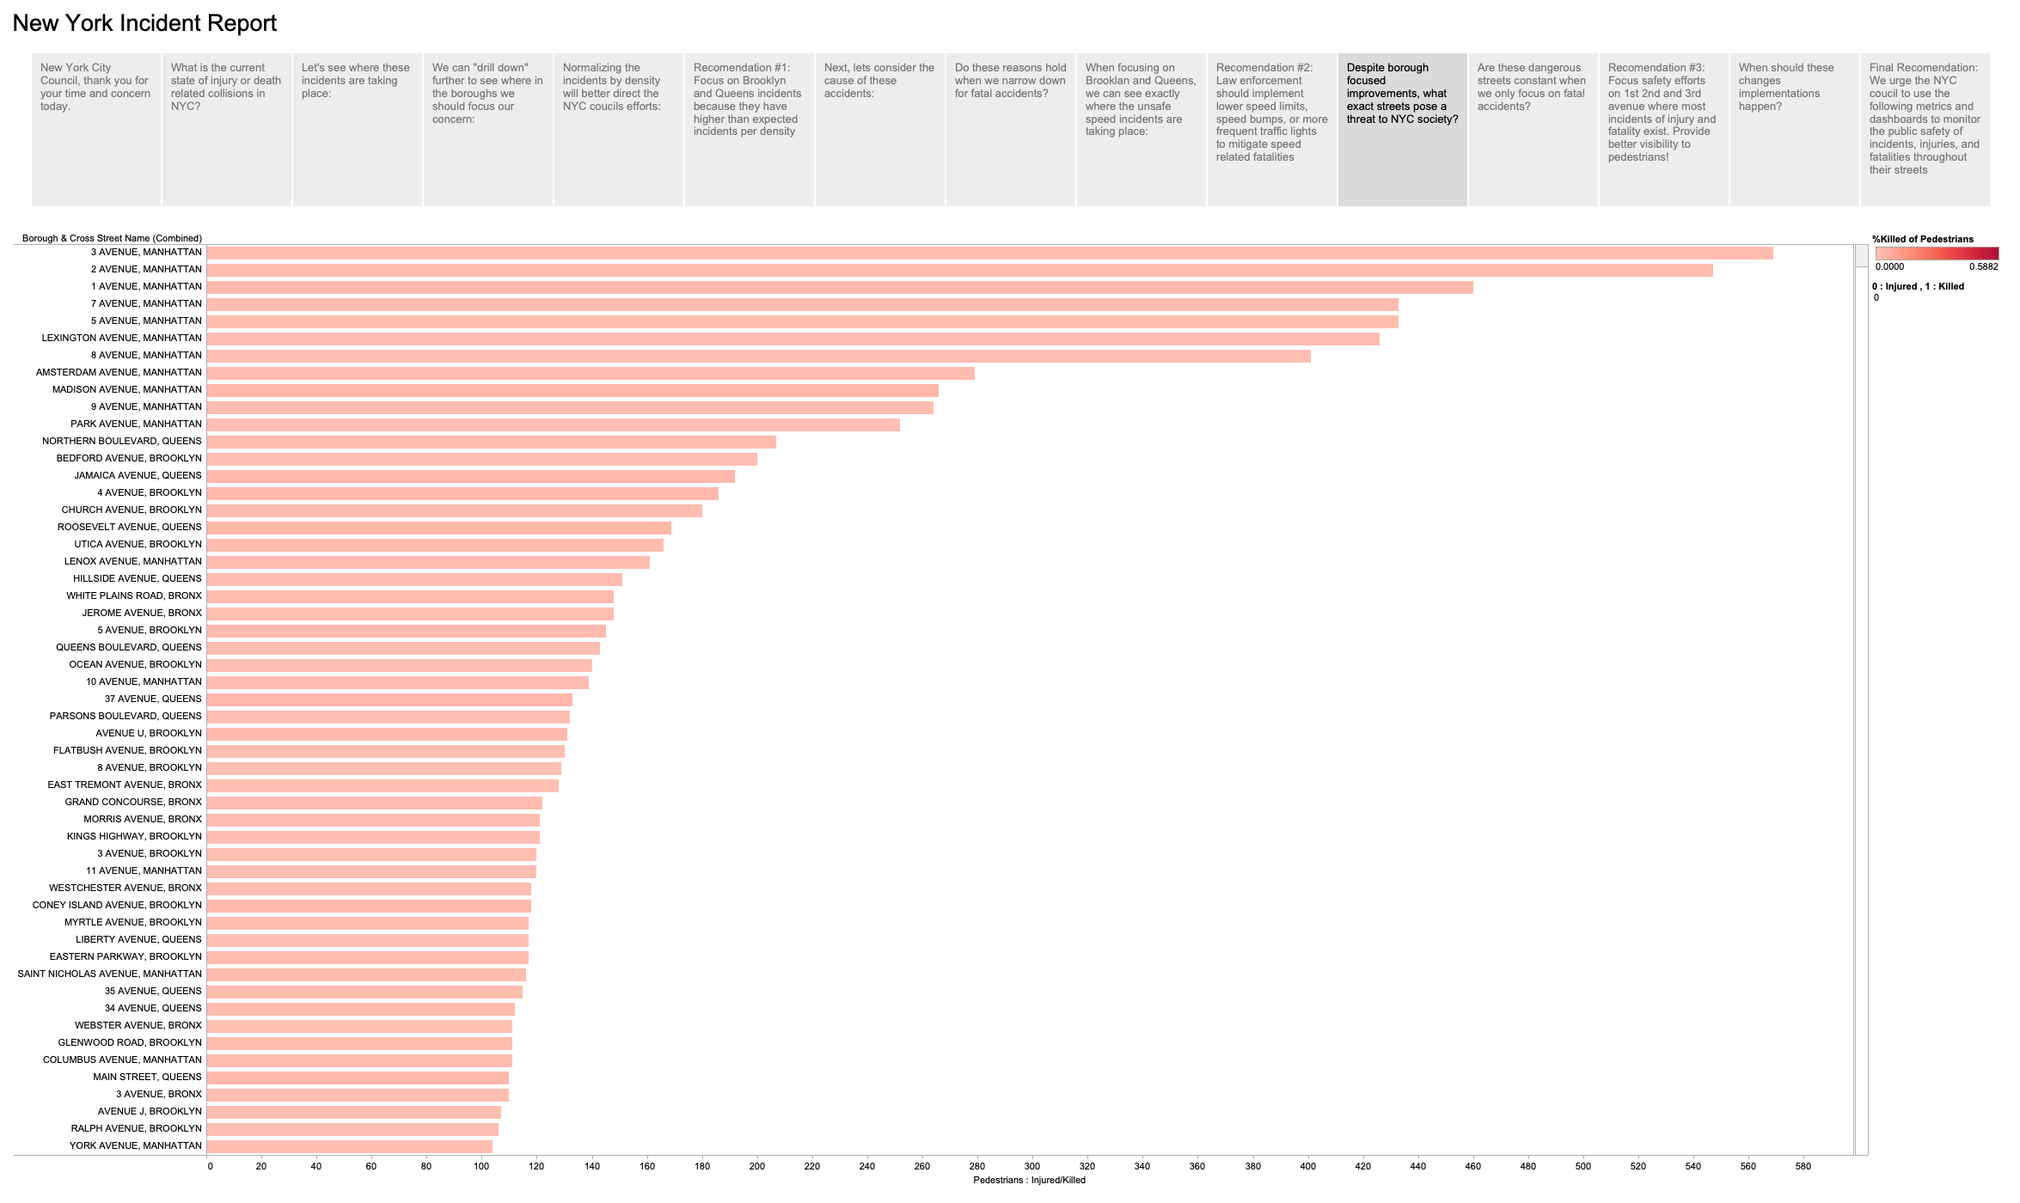
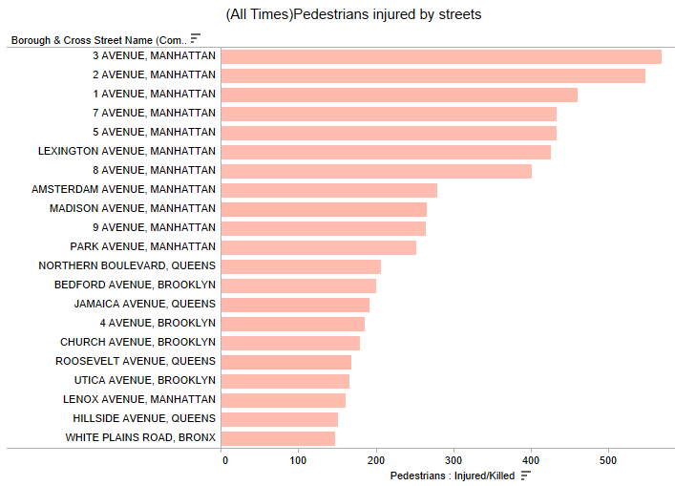
What roads are most dangerous?
3rd Ave
2nd Ave
1st Ave
7th Ave
5th Ave

Slide 12
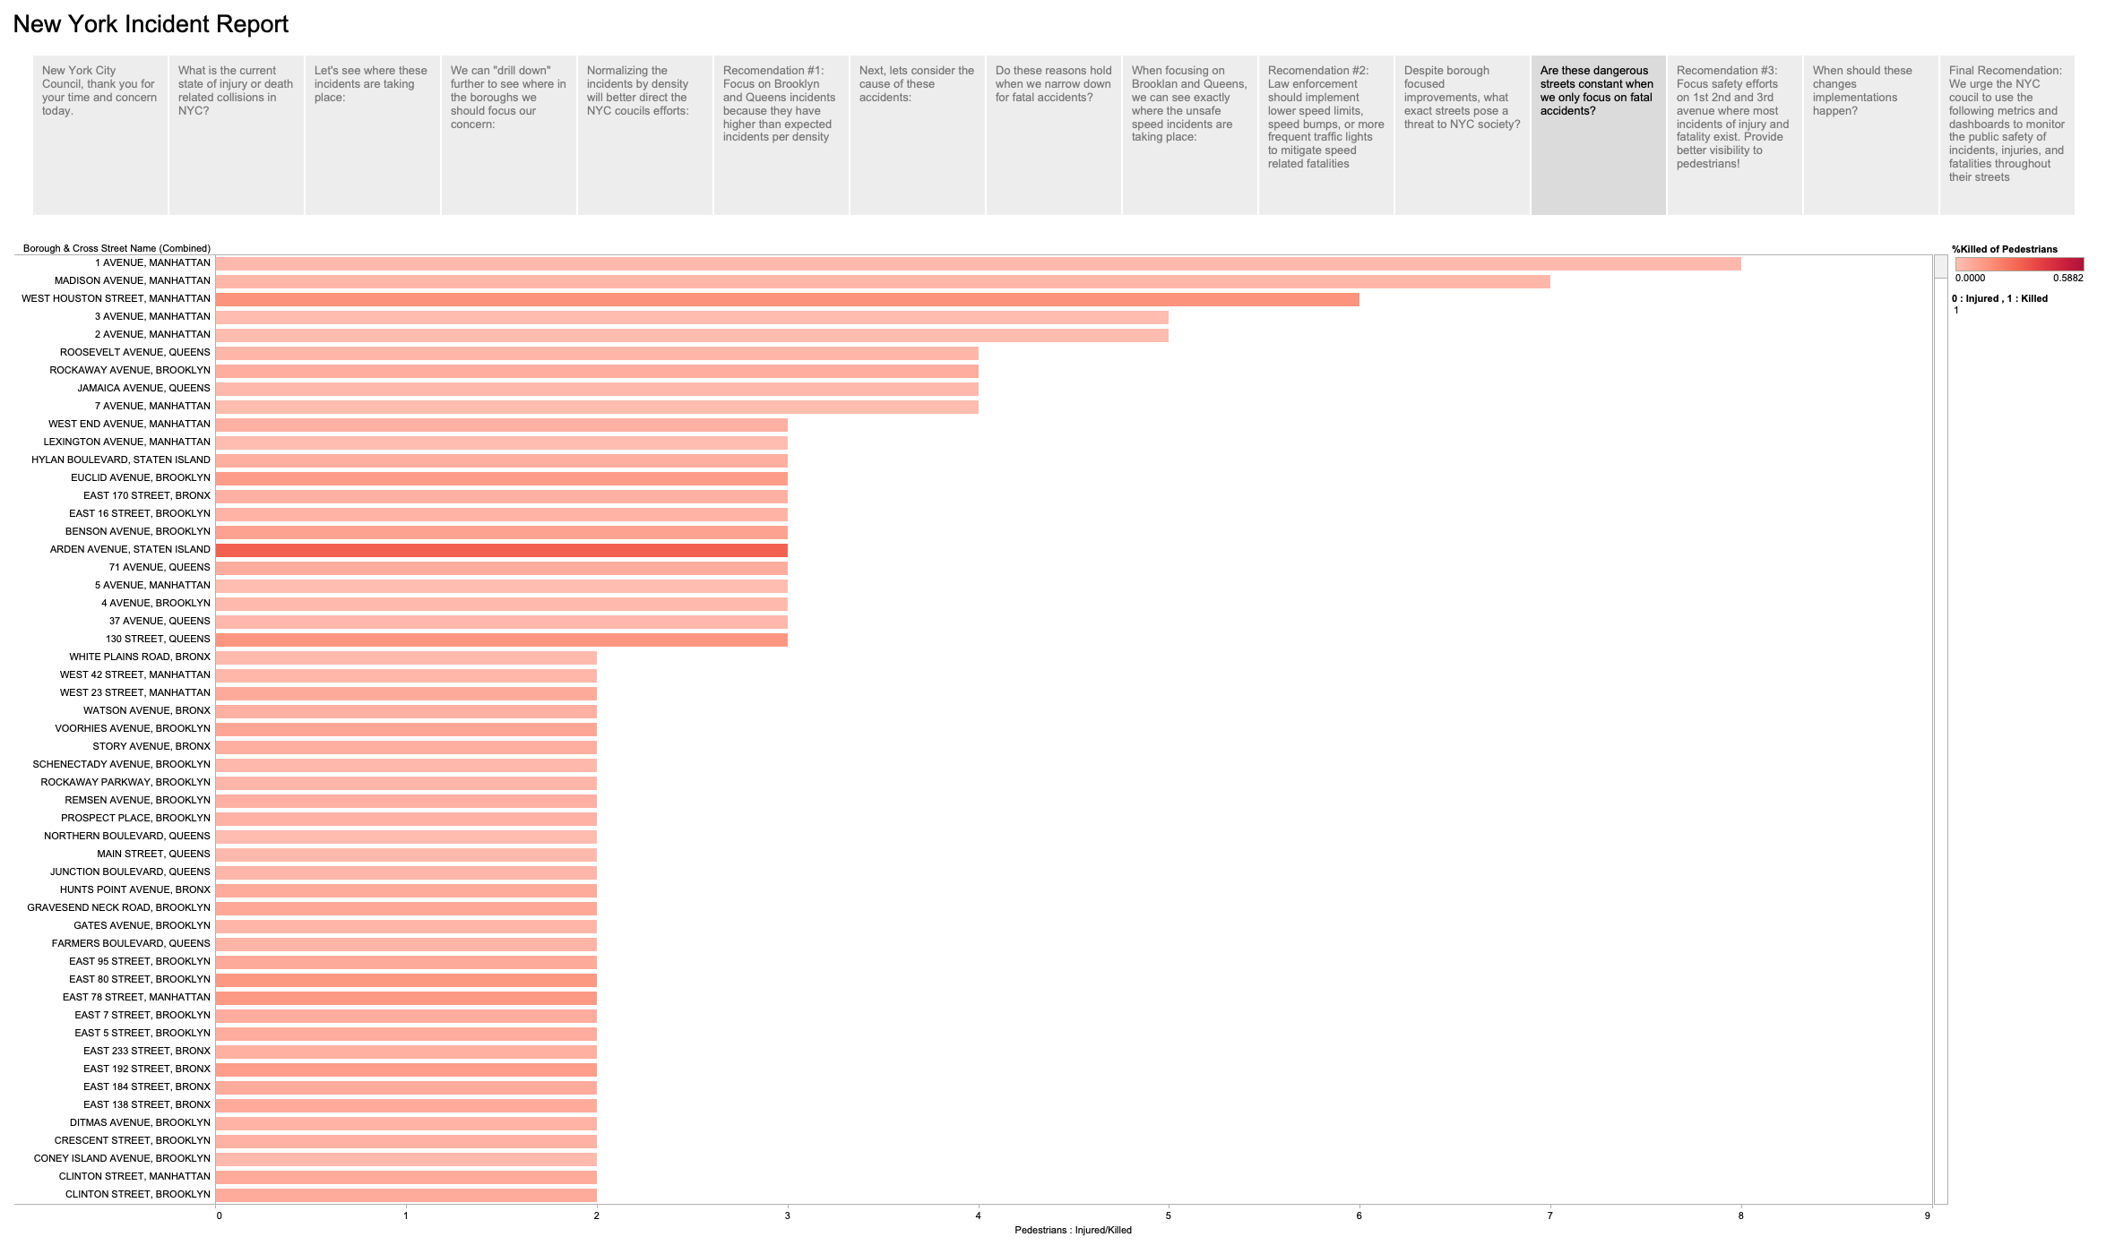
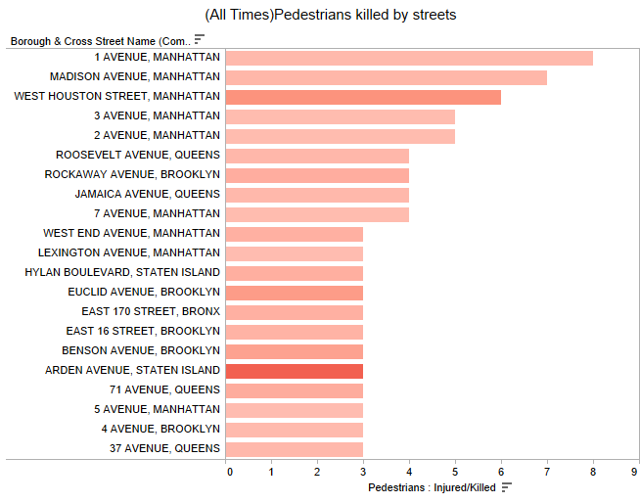
What roads are most dangerous?
1st Ave
Madison Ave
West Houston St
3rd Ave
2nd Ave

Slide 13
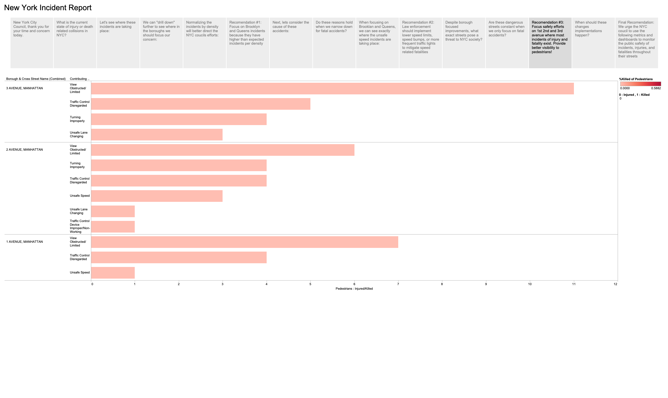
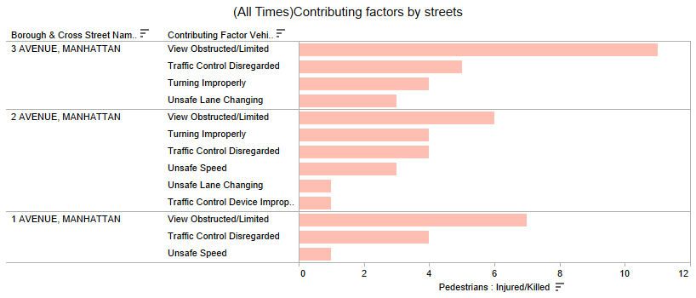
On the most dangerous street, we have discovered the most common factors in injured cases. This mean that the NYC Council can address obstructed views and speed violations in the most dangerous areas outside of Brooklyn and Queens

Slide 14
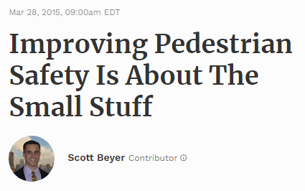
Forbes magazine reported the following when discussing pedestrian safety:
“By converting a parking space at the crosswalk to a red painted curb,” wrote Jose, “a child or a senior doesn’t have to tiptoe into the street just to be able to see if vehicles are about to enter the intersection. And at the same time, people driving have a clear view of the intersection and can see if someone is waiting to cross.”
San Francisco has already applied the measure at 80 intersections within the Tenderloin, a notoriously congested neighborhood, as part of an initiative to end traffic deaths by 2024.
SourceLink
On the most dangerous street, we have discovered the most common factors in injured cases. This mean that the NYC Council can address obstructed views and speed violations in the most dangerous areas outside of Brooklyn and Queens

Slide 15
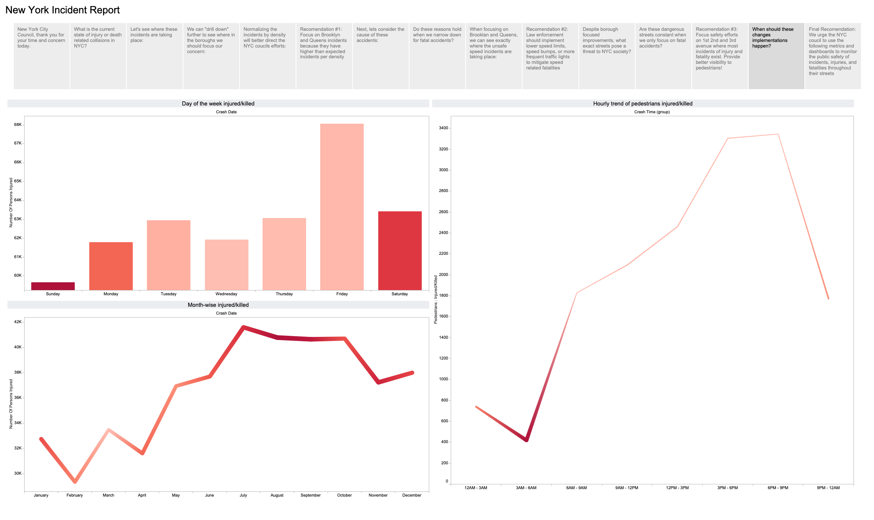

Slide 16
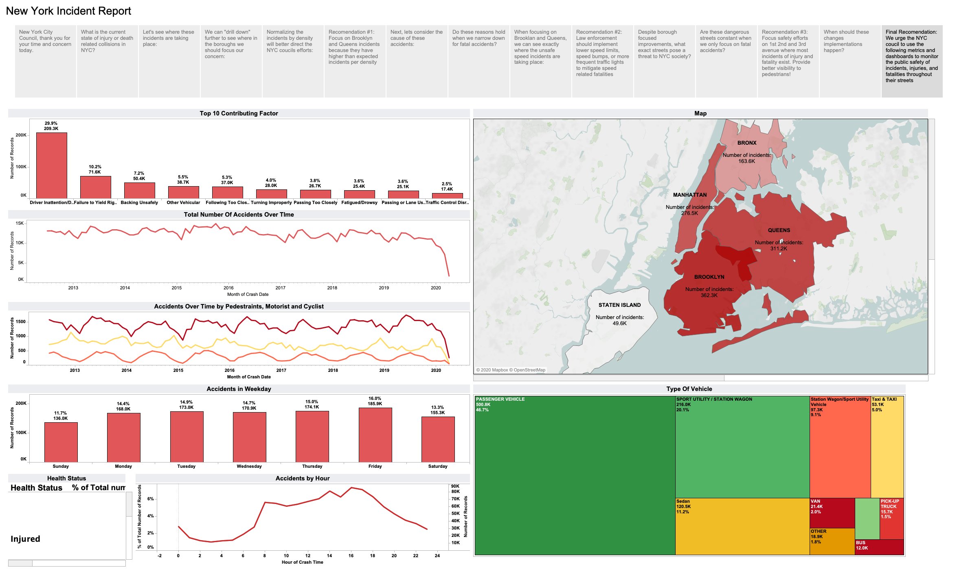

Slide 17
